Slide 1

EDC facts
Contributions to the development of Dataspaces

Slide 2
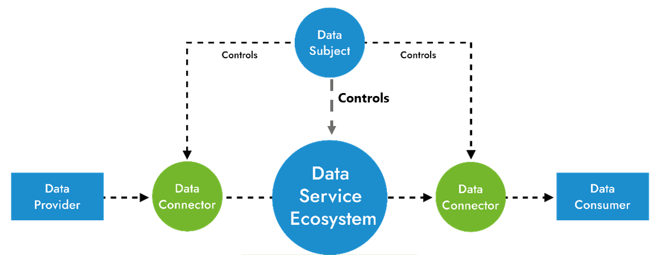
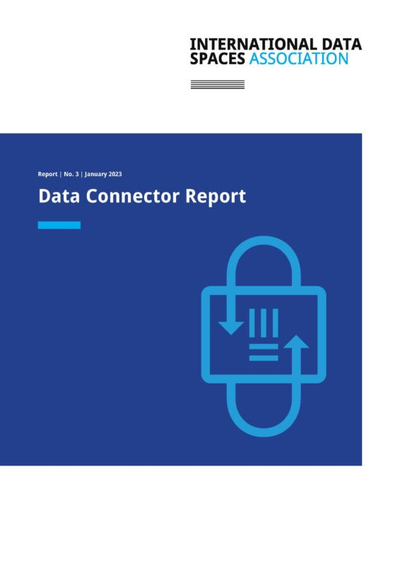
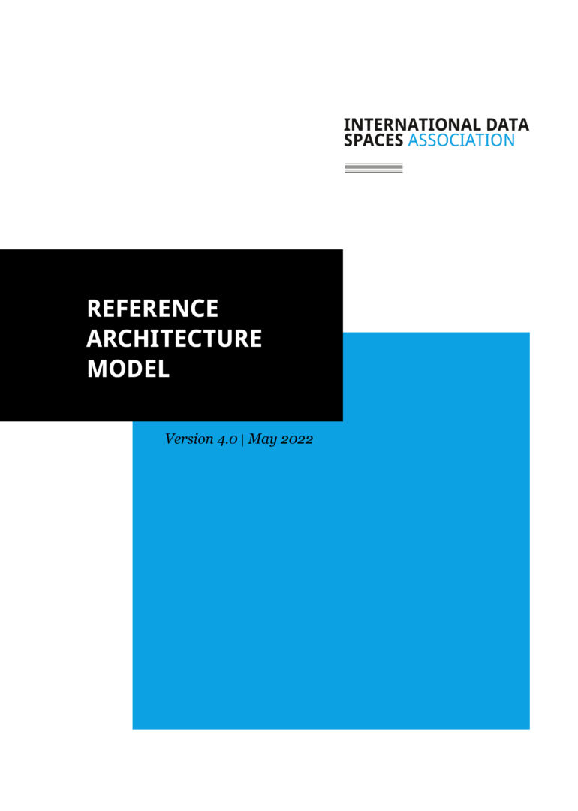
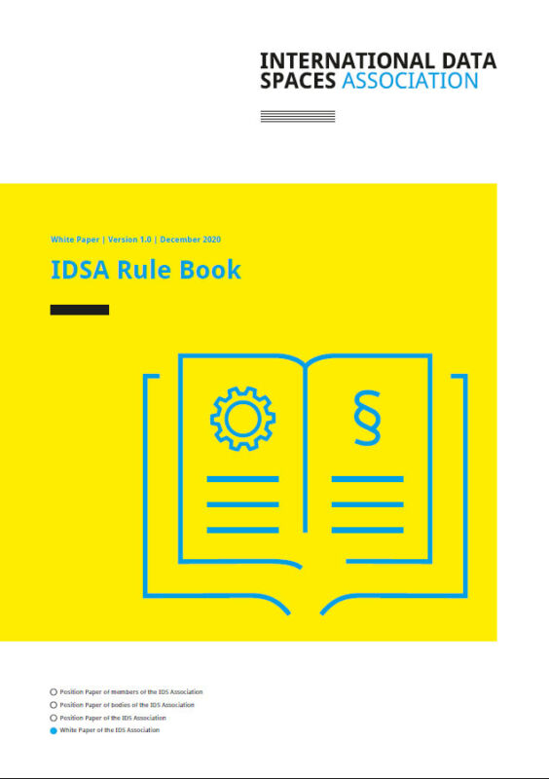
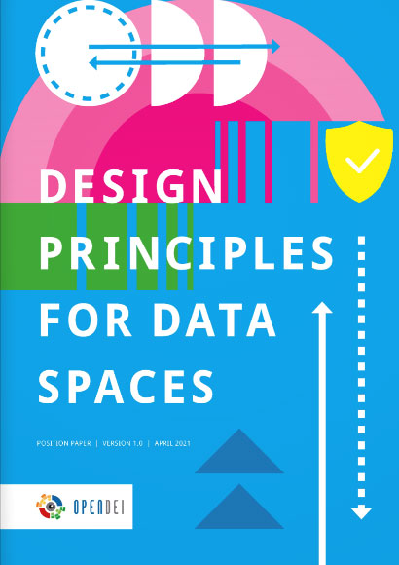
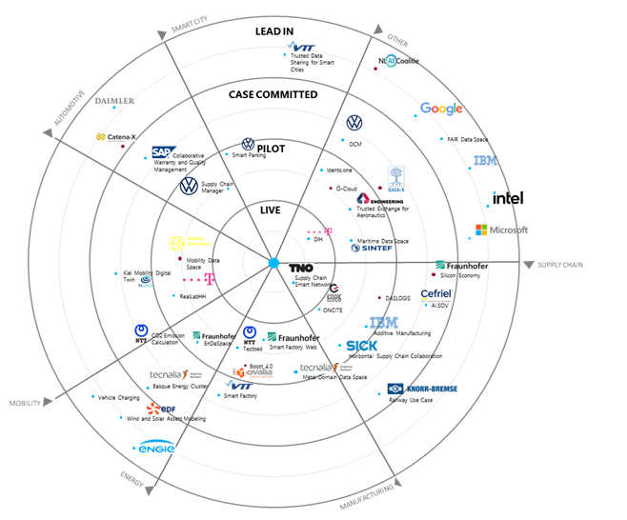
International Data Spaces Association - IDSA
Founded in 2016 as member association with 130+ international members today.
Our goal
is the creation of a standard for data exchange and data sharing while maintaining data sovereignty → Data Spaces
and the adoption of this in data space use cases
100+ projects on Data Space Radar
+ more
Data
Connector
Report
Reference
Architecture
Model
Rulebook
Design Principles for Data Spaces

Slide 3
Many players
To bring our approach to life
Contribute and use
Market
Commercial Software ⋅ Data Markets ⋅ Technology Development ⋅ Open Source Software ⋅ Service Offerings (e.g. Certification) ⋅ Roll-out and Scale-up Activities ⋅ Professional Services ⋅ Domain-specific (vertical) Implementations ⋅ Standardization ⋅ …
Open Source
Not-for-Profit Organization (IDSA)
Reference Architecture Model Maintenance ⋅ Certification Scheme Maintenance ⋅ Certification ⋅ Rulebook Maintenance ⋅ Requirements Management ⋅ Standardization Activities ⋅ Knowledge Transfer ⋅ Internationalization ⋅ Platform for Domain-Specific Activities …
use
Contribute and use
Research
Reference Architecture Model (RAM, initial version) ⋅ Prototype Implementation in Use-Cases ⋅ Basic Versions IDS Components ⋅ Knowledge Transfer (Research Delivery and Support Center) ⋅ Technology Innovation (Usage Control, Trusted Connector etc.) Support of Standardization Activities ⋅ …

Slide 4



IDSA Open-Source Graduation Scheme
Alignment and assessment of Open-Source Data Space components in 3 stages
Sandbox stage
Components with continuous development, which are aligned with the general strategy of IDSA, not fully compliant to IDS specifications, including new concepts to be integrated.
Currently: EDC, TRUE Connector, DataSpace Connector
Incubation stage
Components fully compliant to realized IDS specifications. Aligned with the general strategy and under continuous development.
Currently: -
Graduated stage
Incubated components that are actively used by multiple partners in industrial practice.
Currently: -
Click to see projects part of IDS Graduation Scheme

Slide 5


Quick Facts
Eclipse Data Space Components
Eclipse
Dataspace Components
- EDC -
1
Open Source
started in June 2021 ‧ official Eclipse Foundation project ‧ Apache 2.0 License
2
Community
15 committers ‧ 20+ contributors ‧ 20+ projects ‧ >3200 issues and PR for Connector
3
Technology
based on Java ‧ extensible architecture
4
Goal: Enterprise-ready Dataspace Components
scalable ‧ highly available ‧ customizable
5
Current State
runnable code ‧ basic end to end samples ‧ multiple functionalities ‧ growing user base

Slide 6




Resources
Where to start
Eclipse Foundation
Eclipse project page: https://projects.eclipse.org/projects/technology.edc
Community mailing list: edc-community@eclipse.org
Discord: https://discord.gg/n4sD9qtjMQ
GitHub
Find us on GitHub: https://github.com/eclipse-edc
Main Repository: https://github.com/eclipse-dataspaceconnector/DataSpaceConnector
Documents & presentations: https://github.com/eclipse-dataspaceconnector/Collateral
Publications: https://github.com/eclipse-dataspaceconnector/Publications
Minimum Viable Dataspace: https://github.com/eclipse-edc/MinimumViableDataspace
Documentation: https://eclipse-edc.github.io/docs/#/
YouTube Channel: https://www.youtube.com/channel/UCYmjEHtMSzycheBB4AeITHg

Slide 7
Getting started with EDC
Get your hands on EDC
Eclipse
Dataspace Components
Connector
1
Read the docs
Start with the documentation page
https://eclipse-edc.github.io/docs/#/
2
Build your own connector
Start building your own connector
https://eclipse-edc.github.io/docs/#/submodule/Connector/docs/developer/build-your-own-connector
3
Visit the samples
Find samples that help you exploring EDC
https://github.com/eclipse-edc/Samples
4
Minimum Viable Dataspace
Build your own boilerplate for a Data Space
https://eclipse-edc.github.io/docs/#/submodule/MinimumViableDataspace/
5
Join the community
Biweekly contributors meeting on Discord
https://discord.gg/n4sD9qtjMQ

Slide 8
What you can do to contribute
Code (Create, Improve, Test)
Test/Use and open issues
Make it beautiful (Designers are needed)
Suggest new features
Translate
Create/Update documentation
Build a community
Triage bugs
Project Management & Marketing (Website launch, LinkedIn, Explainer docs and videos,….)
Donate

Slide 9
Contributing in three steps
README
CONTRIBUTING
LICENSE
DISCUSSIONS
Keep an eye on those files. They have valuable information to get you started
Create an issue
Check existing issues
Be clear
Link to demos
Include system details
Paste error output
Pull Request
Fork the repository
Create a branch
Be clear
It‘s best to test
Include screenshots
Contribute in the style of the project
1
2
3

Slide 10

Start contributing
Your community needs your expertise!

Slide 11
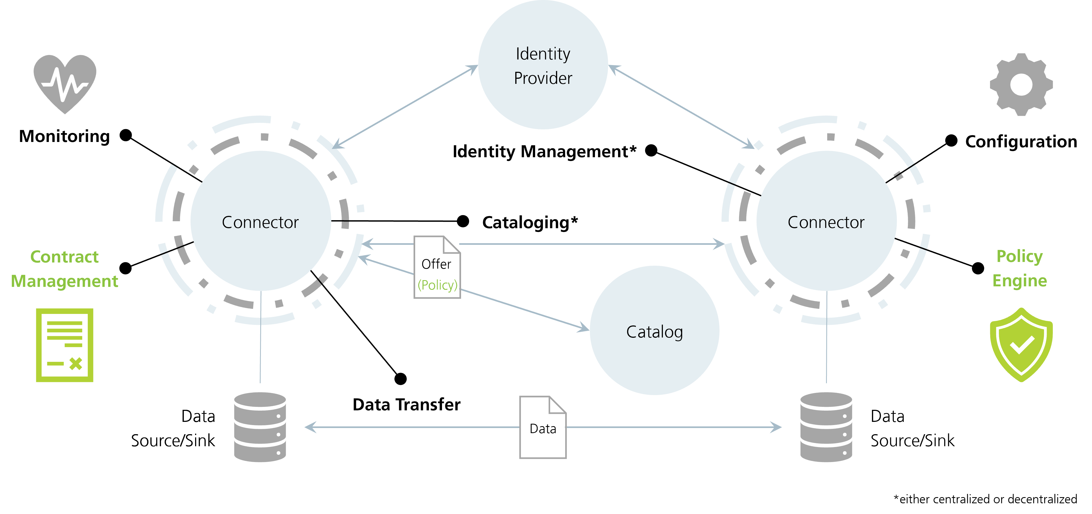
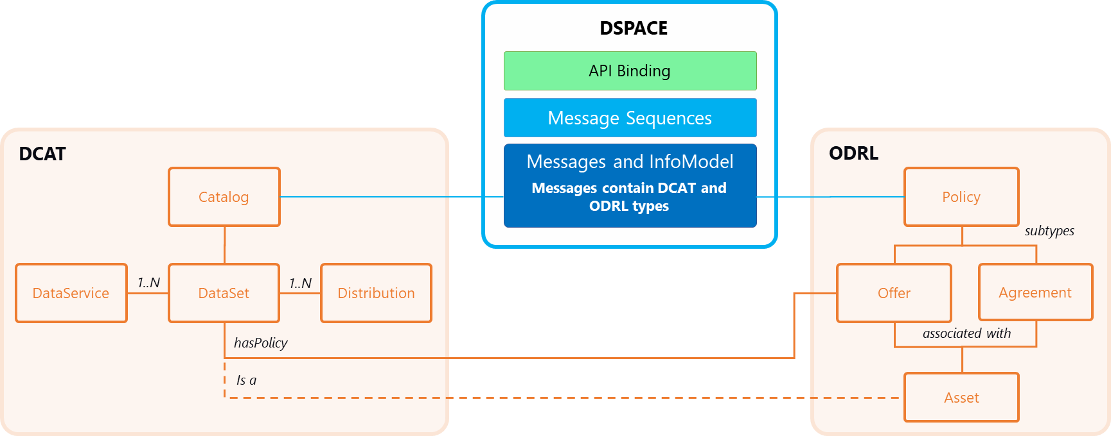
About EDC
EDC implements the IDS Dataspace Protocol
The Dataspace Protocol defines the interactions between the control planes of the connectors
Catalog
Contract Negotiation Sequence
Data Transfer Management
The EDC implements the control plane of the IDS Connectors. Extensions are used to realize data planes, interactions with identity providers and beyond
In scope of
Dataspace Protocol

